Slide 1
Programming Paradigms
CS 345
Vitaly Shmatikov
slide <number>

Slide 2
Reading Assignment
Mitchell, Chapter 2.1
slide <number>

Slide 3
What Is a Programming Language?
Formal notation for specifying computations, independent of a specific machine
  Example: a factorial function takes a single non-negative integer argument and computes a positive integer result
    Mathematically, written as fact: nat → nat
Set of imperative commands used to direct computer to do something useful
  Print to an output device: printf(“hello world\n”);
    What mathematical function is “computed” by printf?
slide <number>

Slide 4
Partial and Total Functions
Value of an expression may be undefined
  Undefined operation, e.g., division by zero
    3/0 has no value
    Implementation may halt with error condition
  Nontermination
    f(x) = if x=0 then 1 else f(x-2)
    This is a partial function: not defined on all arguments
    Cannot be detected by inspecting expression (why?)
These two cases are “mathematically” equivalent, but operationally different (why?)
Subtle: “undefined” is not the name of a function value …
slide <number>

Slide 5
Partial and Total: Definitions
Total function f:A→B is a subset f ⊆ A×B with
  ∀ x∈A, there is some y∈B with ⟨x,y⟩ ∈ f (total)
  If ⟨x,y⟩ ∈ f and ⟨x,z⟩ ∈ f then y=z (single-valued)
Partial function f:A→B is a subset f ⊆ A×B with
  If ⟨x,y⟩ ∈ f and ⟨x,z⟩ ∈ f then y=z (single-valued)
Programs define partial functions for two reasons
  What are these reasons?
slide <number>

Slide 6
Computability
Function f is computable if some program P computes it
  For any input x, the computation P(x) halts with output f(x)
  Partial recursive functions: partial functions (int to int) that are computable
slide <number>

Slide 7
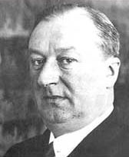

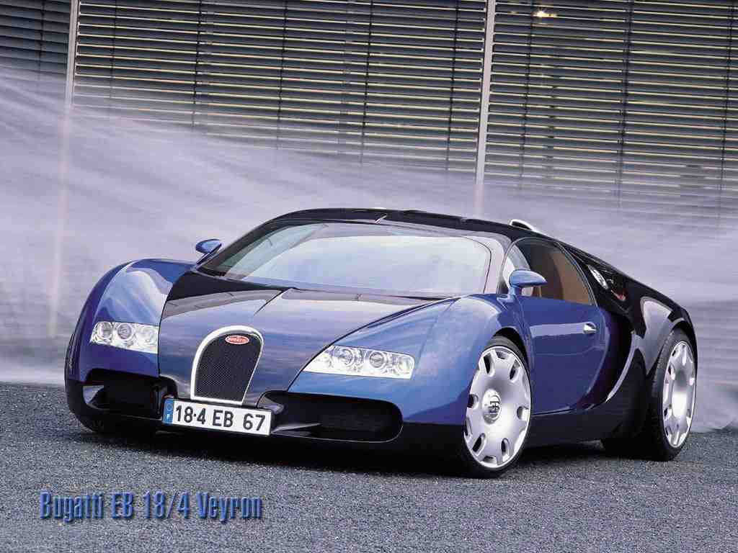
Halting Problem
Ettore Bugatti: "I make my cars to go, not to stop"
slide <number>

Slide 8
Halting Function
Decide whether program halts on input
  Given program P and input x to P,
  Halt(P,x) =
Fact: There is no program for Halt
yes if P(x) halts
no otherwise
Clarifications
  Assume program P requires one string input x
  Write P(x) for output of P when run in input x
  Program P is string input to Halt
slide <number>

Slide 9
Unsolvability of the Halting Problem
Suppose P solves variant of halting problem
  On input Q, assume P(Q) =
Build program D
  D(Q) =
If D(D) halts, then D(D) runs forever
If D(D) runs forever, then D(D) halts
Contradiction! Thus P cannot exist.
yes if Q(Q) halts
no otherwise
run forever if Q(Q) halts
halt if Q(Q) runs forever
slide <number>

Slide 10
Main Points About Computability
Some functions are computable, some are not
  Example: halting problem
Programming language implementation
  Can report error if program result is undefined due to an undefined basic operation (e.g., division by zero)
  Cannot report error if program will not terminate
slide <number>

Slide 11
Computation Rules
The factorial function type declaration does not convey how the computation is to proceed
We also need a computation rule
  fact (0) = 1
  fact (n) = n * fact(n-1)
This notation is more computationally oriented and can almost be executed by a machine
slide <number>

Slide 12
Factorial Functions
C, C++, Java:
  int fact (int n) { return (n == 0) ? 1 : n * fact (n-1); }
Scheme:
  (define fact
  (lambda (n) (if (= n 0) 1 (* n (fact (- n 1))))))
ML:
  fun fact n = if n=0 then 1 else n*fact(n-1);
Haskell:
  fact :: Integer->Integer
  fact 0 = 1
  fact n = n*fact(n-1)
slide <number>

Slide 13
Principal Paradigms
Imperative / Procedural
Functional / Applicative
Object-Oriented
Concurrent
Logic
Scripting
In reality, very few languages are “pure”
  Most combine features of different paradigms
slide <number>

Slide 14
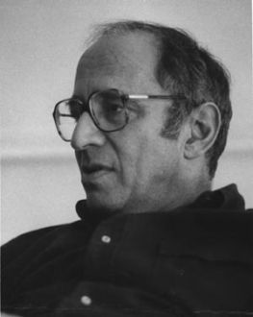
Where Do Paradigms Come From?
Paradigms emerge as the result of social processes in which people develop ideas
and create principles and practices that embody
those ideas
  Thomas Kuhn. “The Structure of Scientific Revolutions.”
Programming paradigms are the result of people’s ideas about how programs should be constructed
  … and formal linguistic mechanisms for expressing them
  … and software engineering principles and practices for using the resulting programming language to solve problems
slide <number>

Slide 15
Imperative Paradigm
Imperative (procedural) programs consists of actions to effect state change, principally through assignment operations or side effects
  Fortran, Algol, Cobol, PL/I, Pascal, Modula-2, Ada, C
  Why does imperative programming dominate in practice?
OO programming is not always imperative, but most OO languages have been imperative
  Simula, Smalltalk, C++, Modula-3, Java
  Notable exception: CLOS (Common Lisp Object System)
slide <number>

Slide 16
Functional and Logic Paradigms
Focuses on function evaluation; avoids updates, assignment, mutable state, side effects
Not all functional languages are “pure”
  In practice, rely on non-pure functions for input/output and some permit assignment-like operators
    E.g., (set! x 1) in Scheme
Logic programming is based on predicate logic
  Targeted at theorem-proving languages, automated reasoning, database applications
  Recent trend: declarative programming
slide <number>

Slide 17
Concurrent and Scripting Languages
Concurrent programming cuts across imperative, object-oriented, and functional paradigms
Scripting is a very “high” level of programming
  Rapid development; glue together different programs
  Often dynamically typed, with only int, float, string, and array as the data types; no user-defined types
  Weakly typed: a variable ‘x’ can be assigned a value of any type at any time during execution
Very popular in Web development
  Especially scripting active Web pages
slide <number>

Slide 18
Unifying Concepts
Unifying language concepts
  Types (both built-in and user-defined)
    Specify constraints on functions and data
    Static vs. dynamic typing
  Expressions (e.g., arithmetic, boolean, strings)
  Functions/procedures
  Commands
We will study how these are defined syntactically, used semantically, and implemented pragmatically
slide <number>

Slide 19
Design Choices
C: Efficient imperative programming with static types
C++: Object-oriented programming with static types and ad hoc, subtype and parametric polymorphism
Java: Imperative, object-oriented, and concurrent programming with static types and garbage collection
Scheme: Lexically scoped, applicative-style recursive programming with dynamic types
Standard ML: Practical functional programming with strict (eager) evaluation and polymorphic type inference
Haskell: Pure functional programming with non-strict (lazy) evaluation.
slide <number>

Slide 20
Abstraction and Modularization
Re-use, sharing, extension of code are critically important in software engineering
Big idea: detect errors at compile-time, not when program is executed
Type definitions and declarations
  Define intent for both functions/procedures and data
Abstract data types (ADT)
  Access to local data only via a well-defined interface
Lexical scope
slide <number>

Slide 21
Static vs. Dynamic Typing
Static typing
  Common in compiled languages, considered “safer”
  Type of each variable determined at compile-time; constrains the set of values it can hold at run-time
Dynamic typing
  Common in interpreted languages
  Types are associated with a variable at run-time; may change dynamically to conform to the type of the value currently referenced by the variable
  Type errors not detected until a piece of code is executed
slide <number>

Slide 22

Billion-Dollar Mistake
Failed launch of Ariane 5 rocket (1996)
  $500 million payload; $7 billion spent on development
Cause: software error in inertial reference system
  Re-used Ariane 4 code, but flight path was different
  64-bit floating point number related to horizontal velocity converted to 16-bit signed integer; the number was larger than 32,767; inertial guidance crashed
slide <number>

Slide 23
Program Correctness
Assert formal correctness statements about critical parts of a program and reason effectively
  A program is intended to carry out a specific computation, but a programmer can fail to adequately address all data value ranges, input conditions, system resource constraints, memory limitations, etc.
Language features and their interaction should be clearly specified and understandable
  If you do not or can not clearly understand the semantics of the language, your ability to accurately predict the behavior of your program is limited
slide <number>

Slide 24
Language Translation
Native-code compiler: produces machine code
  Compiled languages: Fortran, C, C++, SML …
Interpreter: translates into internal form and immediately executes (read-eval-print loop)
  Interpreted languages: Scheme, Haskell, Python …
Byte-code compiler: produces portable bytecode, which is executed on virtual machine (e.g., Java)
Hybrid approaches
  Source-to-source translation (early C++ → C→compile)
  Just-in-time Java compilers convert bytecode into native machine code when first executed
slide <number>

Slide 25
Language Compilation
Compiler: program that translates a source language into a target language
  Target language is often, but not always, the assembly language for a particular machine
C
source code
C
compiler
x86 ASM
x86
assembler
Pentium op codes
slide <number>

Slide 26
Checks During Compilation
Syntactically invalid constructs
Invalid type conversions
  A value is used in the “wrong” context, e.g., assigning a float to an int
Static determination of type information is also used to generate more efficient code
  Know what kind of values will be stored in a given memory region during program execution
Some programmer logic errors
  Can be subtle: if (a = b) … instead of if (a == b) …
slide <number>

Slide 27
Compilation Process
Syntax and static
type errors
Lexical
analyzer
tokens
Syntax
analyzer +
type checker
ASTs
Intermediate
code gen
IC
IC_{opt}
Final code
gen
Optimizer
raw source
code text
ASM
Assembler
Preprocessor
Source code with
preprocessor directives
Machine code
slide <number>

Slide 28
Phases of Compilation
Preprocessing: conditional macro text substitution
Lexical analysis: convert keywords, identifiers, constants into a sequence of tokens
Syntactic analysis: check that token sequence is syntactically correct
  Generate abstract syntax trees (AST), check types
Intermediate code generation: “walk” the ASTs and generate intermediate code
  Apply optimizations to produce efficient code
Final code generation: produce machine code
slide <number>

Slide 29
Language Interpretation
Read-eval-print loop
  Read in an expression, translate into internal form
  Evaluate internal form
    This requires an abstract machine and a “run-time” component (usually a compiled program that runs on the native machine)
  Print the result of evaluation
  Loop back to read the next expression
input
expression
REPL
interpreter
result
Interpreter
runtime
slide <number>

Slide 30
Bytecode Compilation
Combine compilation with interpretation
  Idea: remove inefficiencies of read-eval-print loop
Bytecodes are conceptually similar to real machine opcodes, but they represent compiled instructions to a virtual machine instead of a real machine
  Source code statically compiled into a set of bytecodes
  Bytecode interpreter implements the virtual machine
  In what way are bytecodes “better” then real opcodes?
Bytecode
compiler
Bytecode
interpreter
result
source
program
bytecodes
Virtual machine
runtime
slide <number>

Slide 31
Binding
Binding = association between an object and a property of that object
  Example: a variable and its type
  Example: a variable and its value
A language element is bound to a property at the time that property is defined for it
  Early binding takes place at compile-time
  Late binding takes place at run-time
slide <number>

